Slide 1
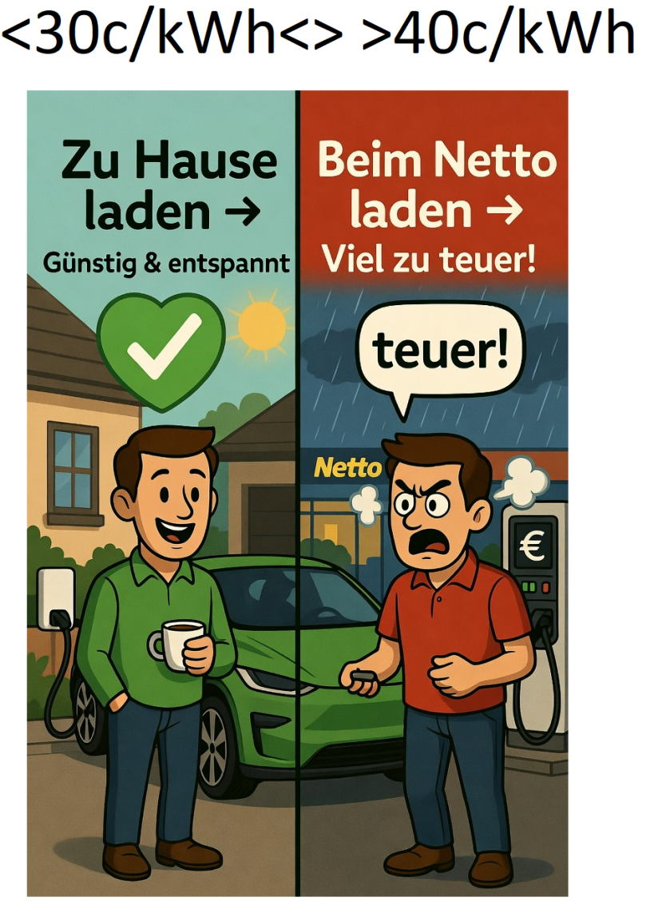

snail vs flash charging

Slide 2
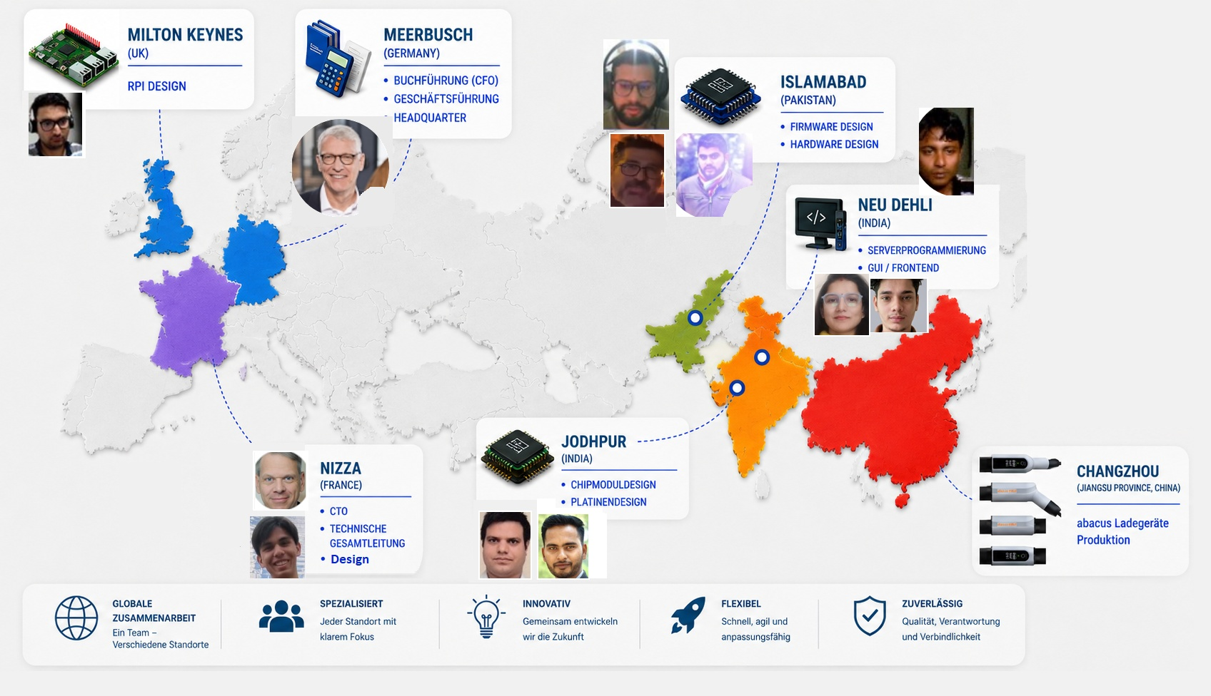
abacus team: lean management

Slide 3


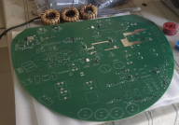
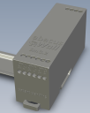
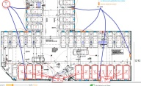

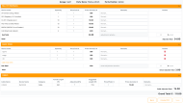
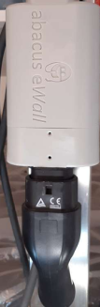

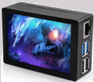
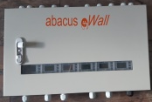
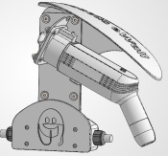
Stairway to heaven
technical structure
vertically
horizontally
BEMS
business strategy
Smart Meter
Bidirex
Install
SW
User
Screen
Billing
SW
Tester HW
Bidi-
adapter
Real estate fund1
NEXT
Elli-VW
RPI
Real estate fund2
Vonovia
Cabinet
enbw
e.on
abacus eControl
Charger & Socket
Market Value
5-50 mio€
20-999 mio€
Link zu Energiesim
Link zu Energie-Erklärung

Slide 4
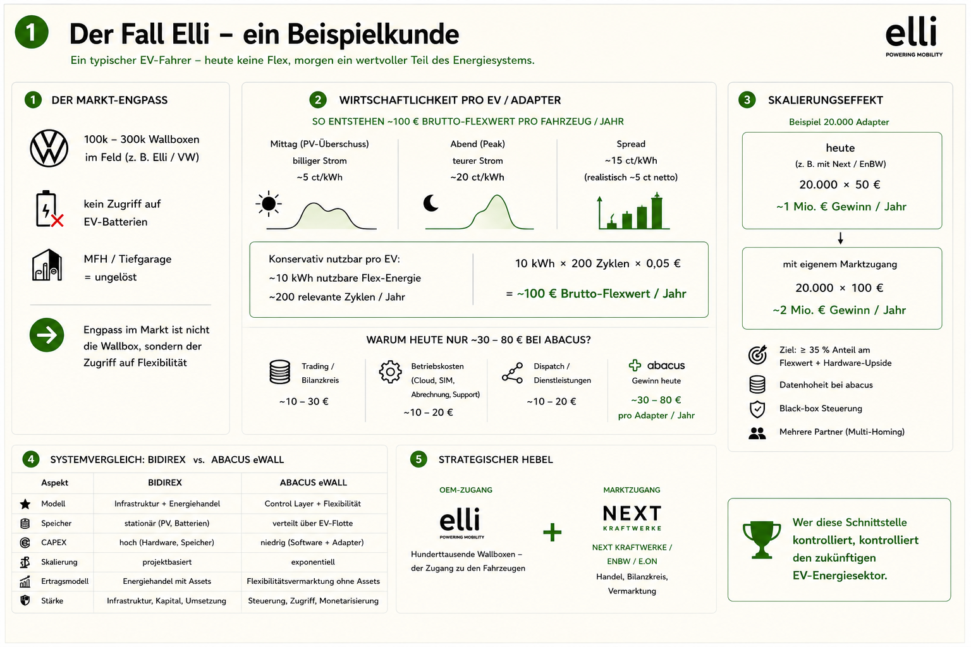

Slide 5
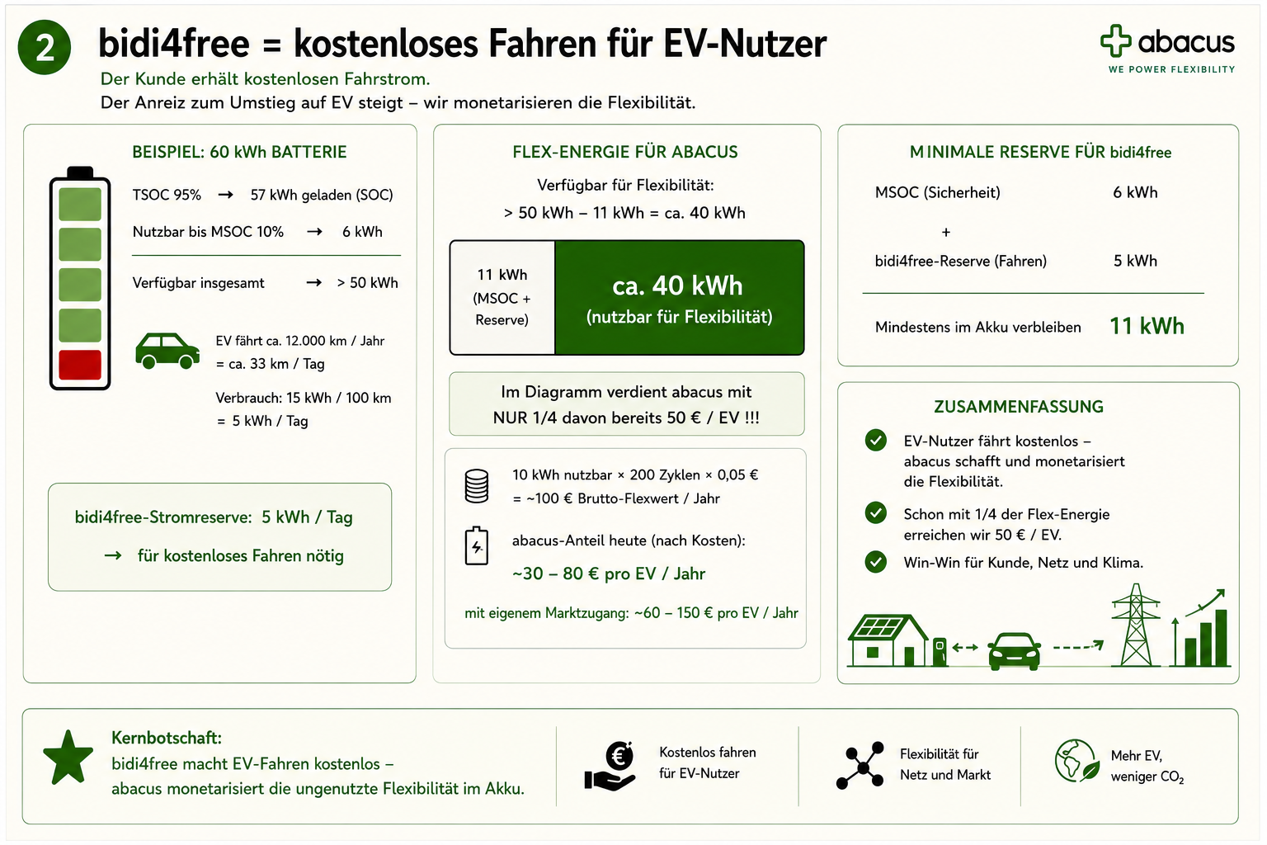

Slide 6
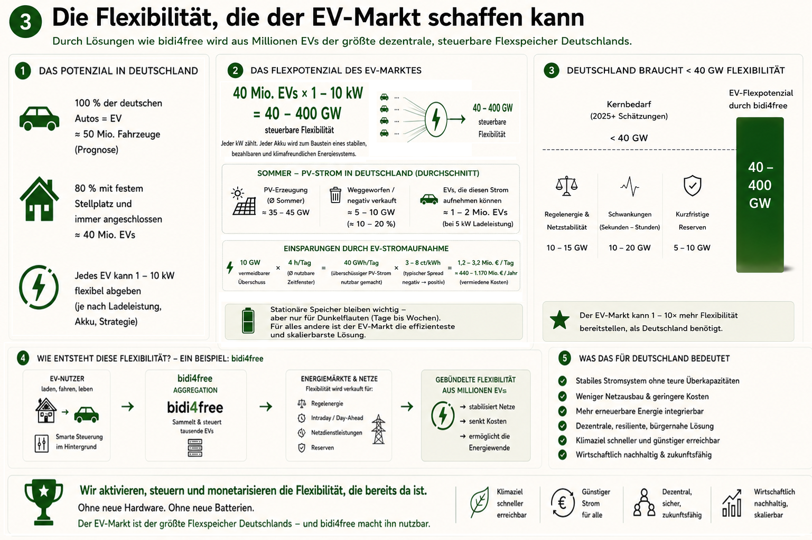

Slide 7
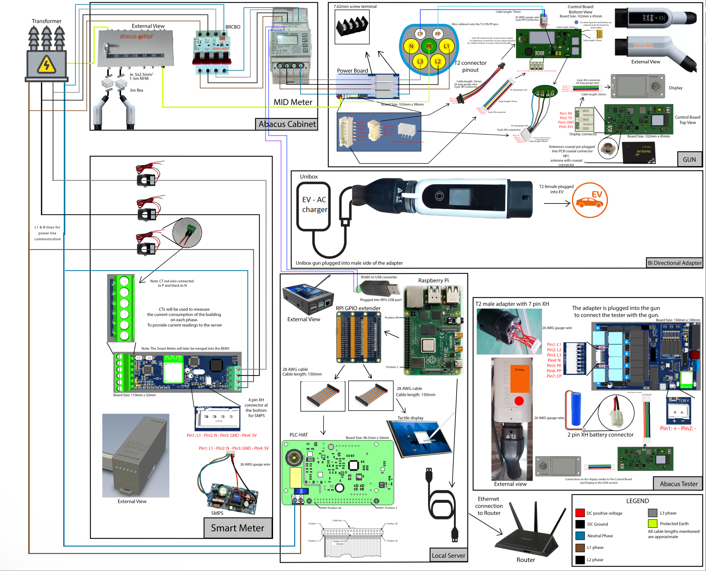
hardware presentation

Slide 8
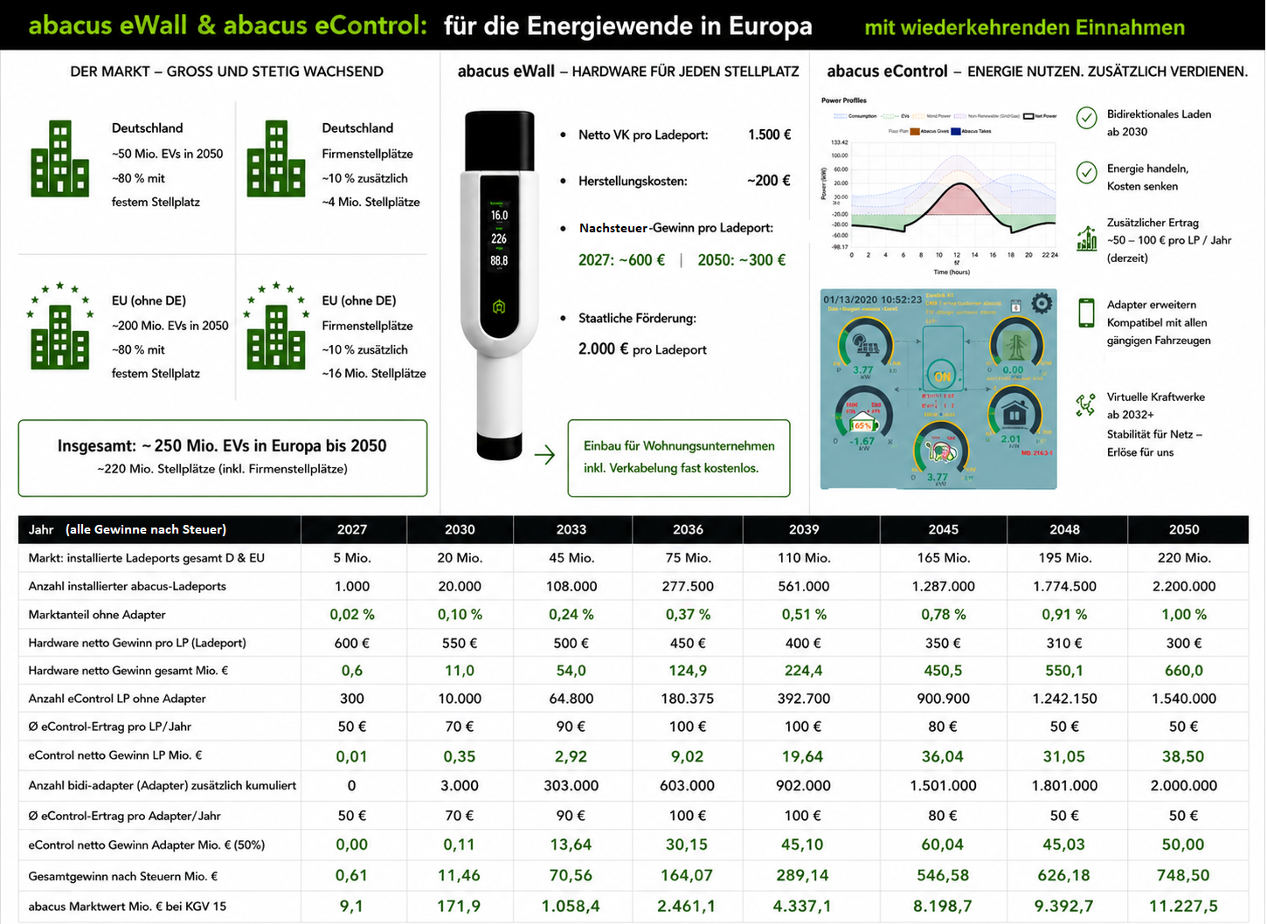
Link zu abacus server
Thank you for listening, questions?

